Slide 2
Sevak Project: A Model for Access to Care in Rural India
Thakor G. Patel, MD, MACP, Chairman, USA
Hemant Patel, MD, Co-Chairman, USA
Ranjita Misra, PhD, Co-Chairman, USA Padmini Balagopal, PhD
Kirtibhai D. Patel, India
affiliates Texas A&M University
M.S.University, India
University of Maryland, MD
Bhartiya Seva Samaj, India Sponsored by
AAPI & Federation of NY-NJ AAPI
Supported by Pfizer Inc.

Slide 3
Sevak
Sevak Project is based on the U.S.Navy model of Independent Duty Corpsman
A village per district (26) was selected from the state of Gujarat
The average population of the village was about 1500-2500
Sevaks were identified with average education of 12th grade and above

Slide 4
Sevak
The state was divided into 4 regions and a coordinator was appointed for each of the region with graduate level education
Sevaks occupation was farming, college or unemployed but had to live in the village to participate in the project
They were brought to Vadodara, provided with lodging, boarding and other support

Slide 5
Sevak
Government Medical College, Vadodara provided faculty for teaching
Yoga and English classes daily each for one hour
Afternoon, clinical lectures and practical
One week in Ahmedabad for environment, sanitation and leadership education

Slide 6
Sevak
Graduation after 10 weeks with competency tests in health education, glucometers, BP and training the trainer.
The Chancellor of M.S.University, also a former Queen of the State of Baroda was the keynote speaker
The project has been approved by the Chief Minister of Gujarat, Mr. Modi

Slide 7
Sevak
The sevaks are in their respective villages doing screening for diabetes and hypertension along with recording other health care problems
They are required to educate the village folks about the merit of having house toilet and smokeless stoves ventilated to the outside

Slide 8
Sevak
The coordinators will meet in Vadodara once a month and are required to visit the villages in their region once every two weeks
Sevaks will meet in Vadodara quarterly and do brainstorming of ideas and lessons learned. Will get refresher training
Video teleconferencing and education of the villages is being looked at, but will require funding

Slide 9
Sevak
This is a three year pilot project to demonstrate that preventive model works in keeping farmers at work without illness. Identifying those with diabetes and hypertension will prevent complications
Such a model has not been tried as a system
The success of this model is very important as it can be applied in any developing country

Slide 10
Prevalence of DM 7 Pre-diabetes in Rural & Urban India

Slide 11
Dr. T.G.Patel with J & J representatives

Slide 12
Sevaks In Ahemedabad

Slide 13
Learning to blood sugar check

Slide 14
Chancellor Addressing the Sevaks

Slide 15
Lecture on public Health

Slide 16
With the Medical school dean & staff

Slide 17
Clinical rotation at the Medical school

Slide 18
Clinical rotation at the medical school

Slide 19
Insulin Cooler

Slide 20
Yoga Class

Slide 21
Cooking stove in the house

Slide 22
Smokeless Stove

Slide 23
Construction of Toilet

Slide 24
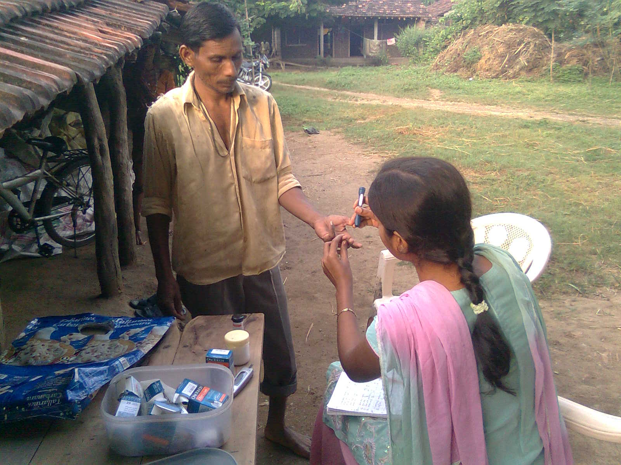
Newly Trained Sevak Checking FBS

Slide 25
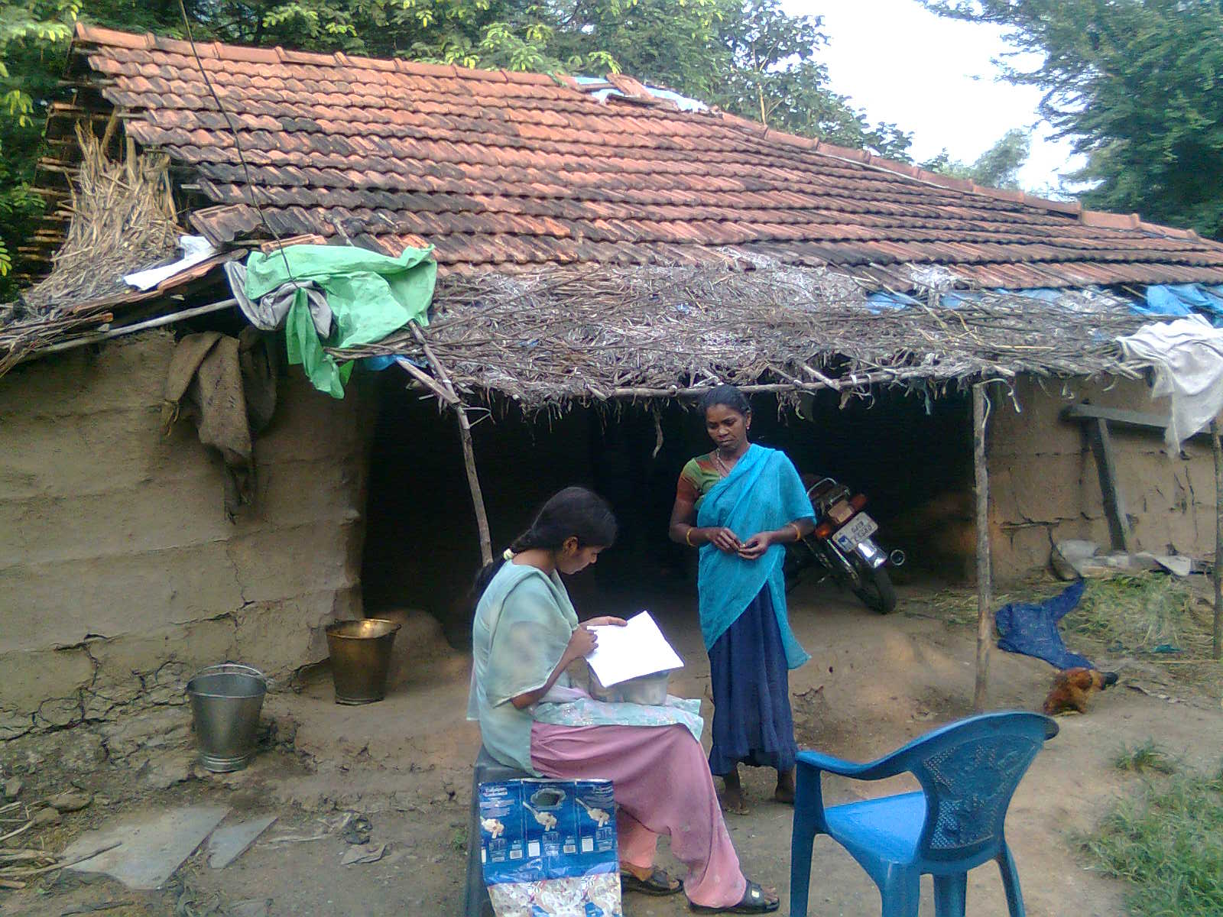
Sevak Collecting Data

Slide 26
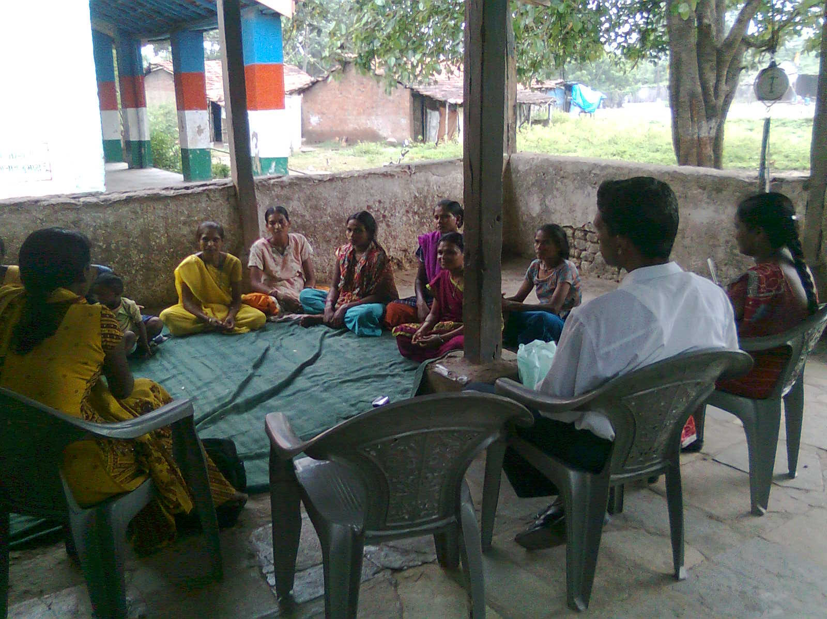
Sevak conducting an education class

Slide 27
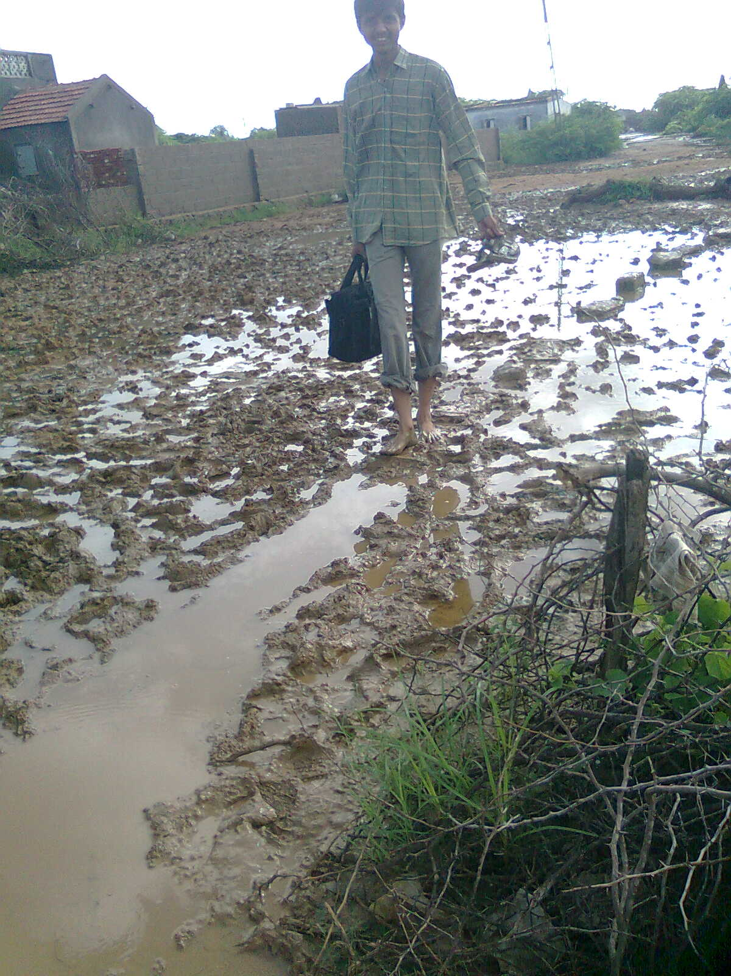
Sevak Visitng Patients in Kutch

Slide 28
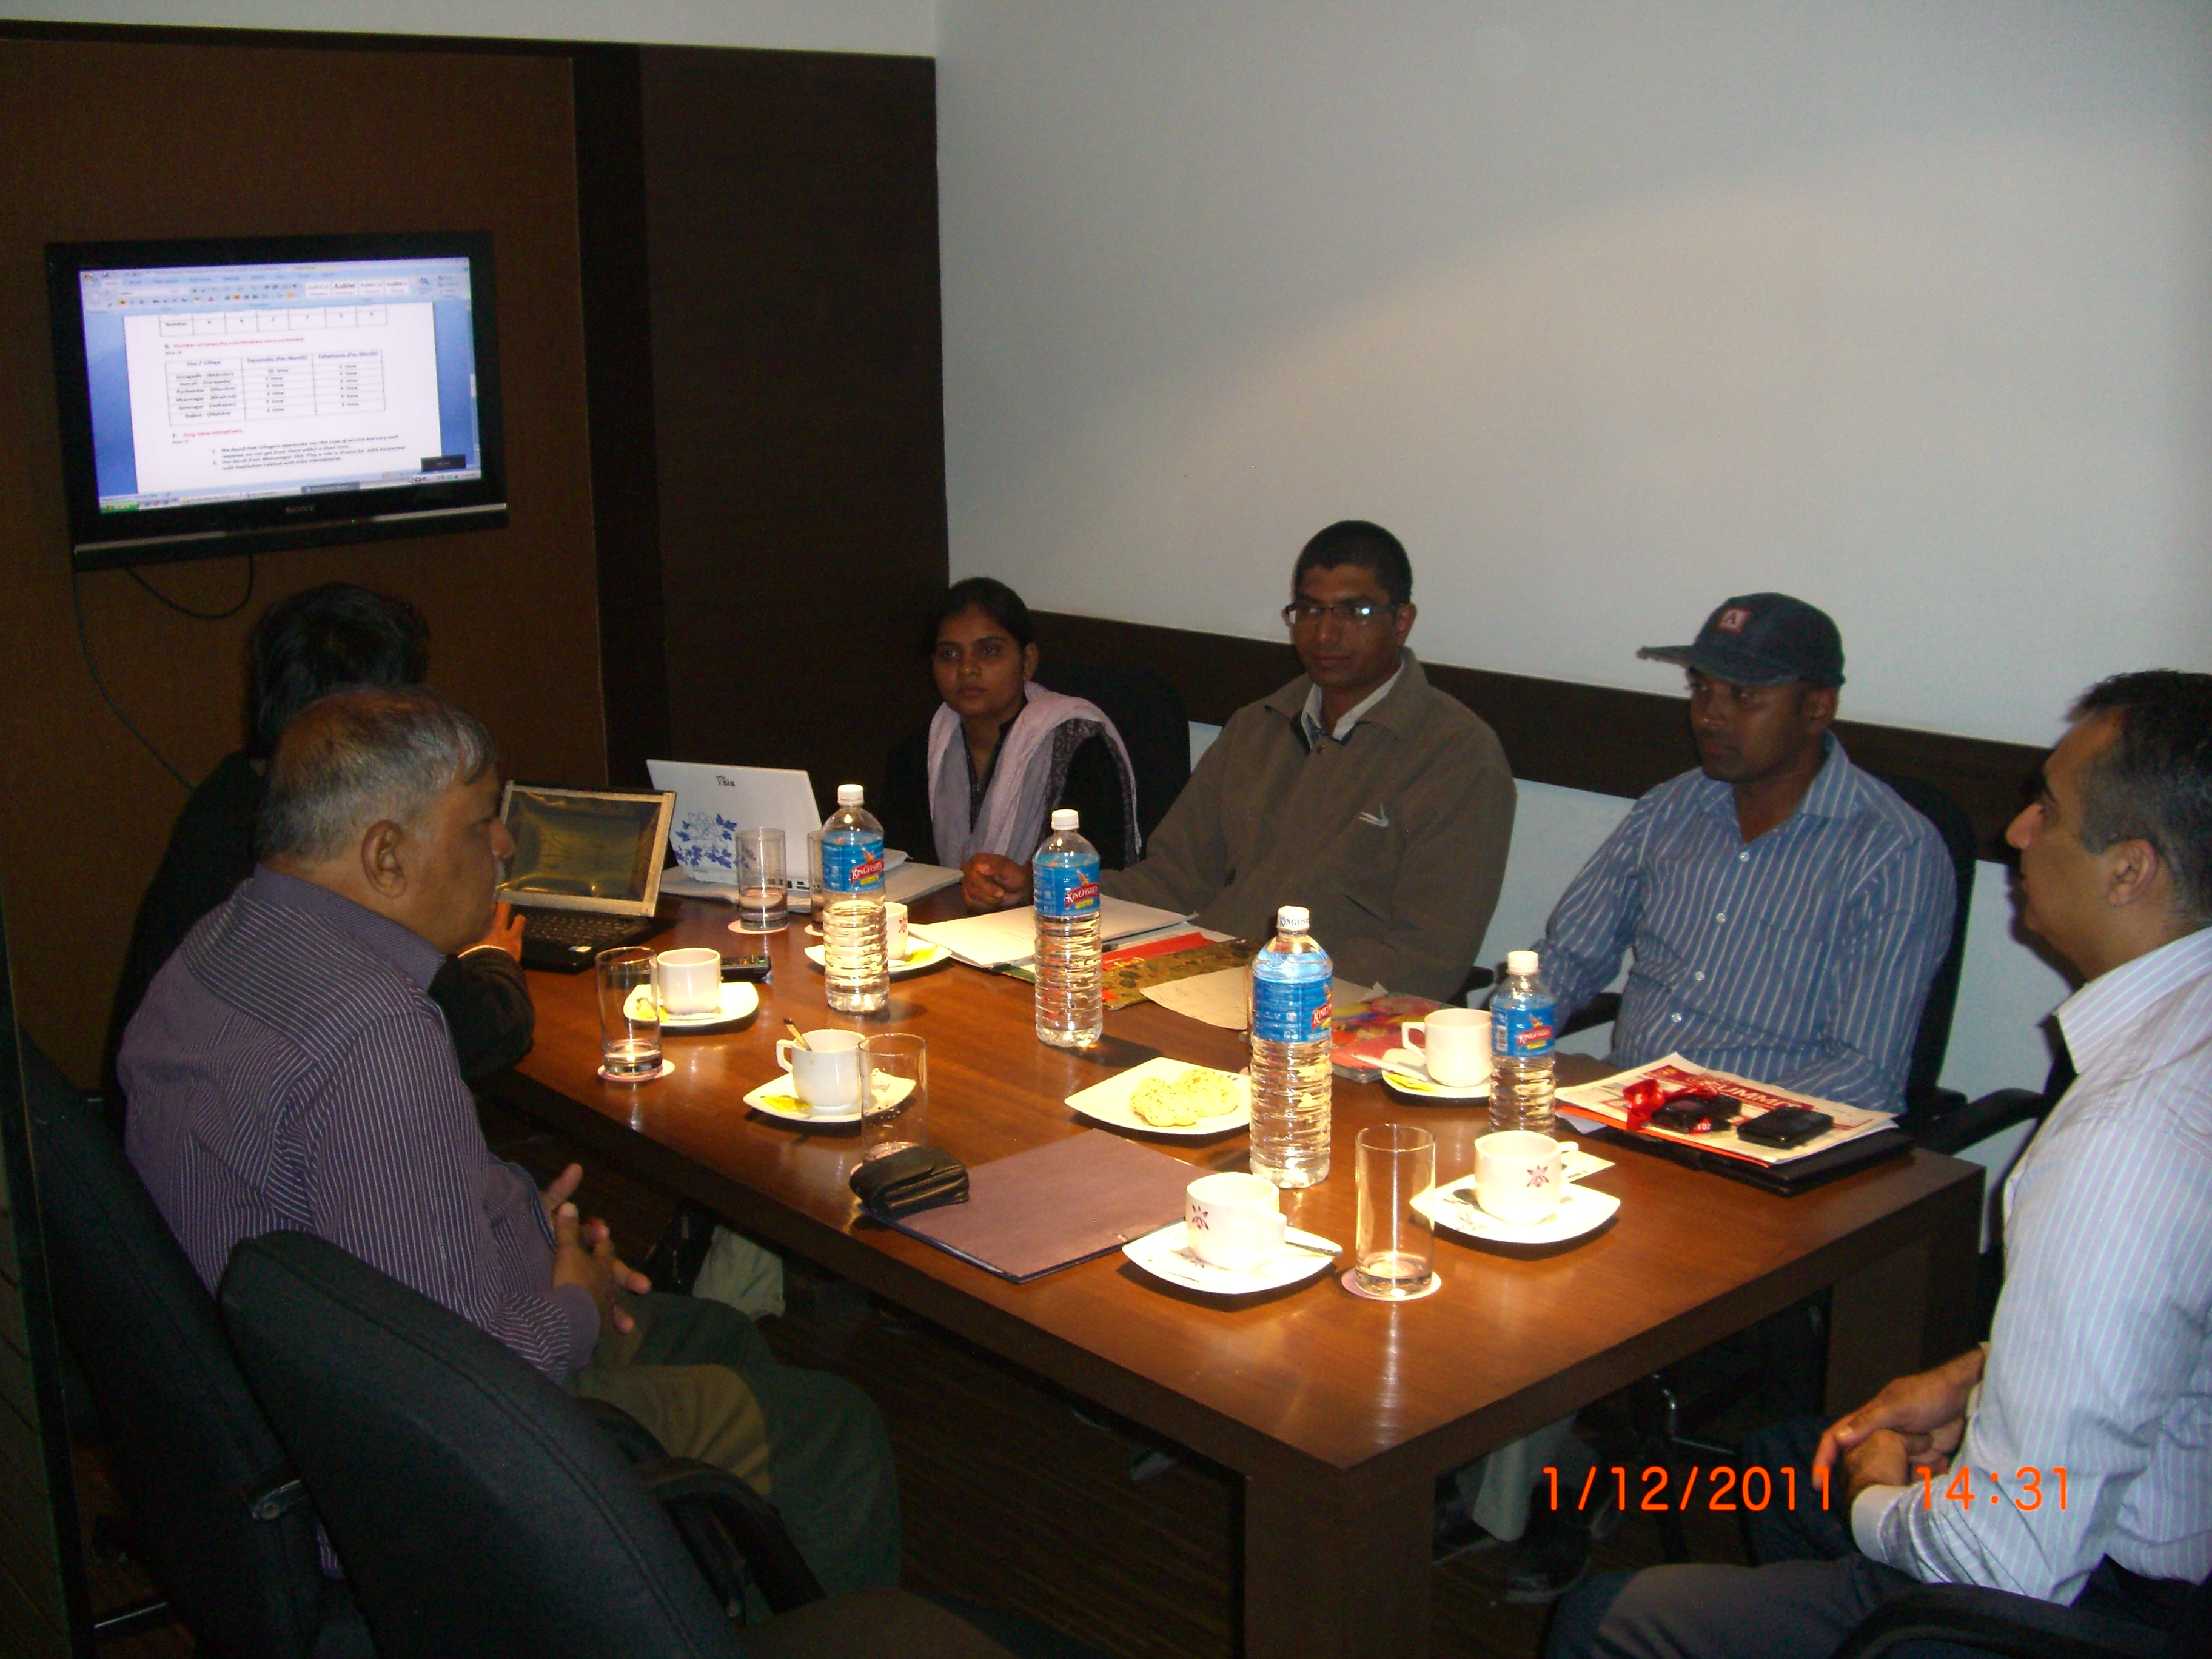

Slide 29
THANK YOU!

